Slide 1
One FW Tool
FW Update and Download
February 2014
Michael Harnischfeger

Slide 2
Document
Version History
Version | Date | Author | Changes
V01 | 25.02.2014 | M. Harnischfeger | First draft
V02 | 26.02.2014 | M. Harnischfeger | Rework after feedback

Slide 3
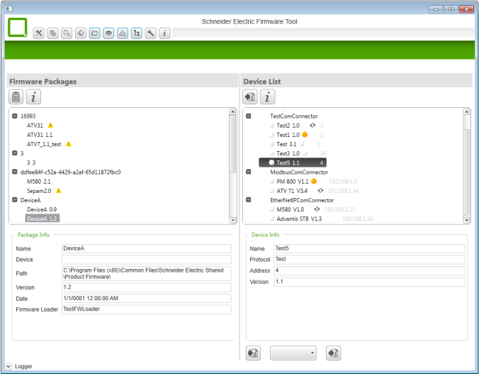
One FW Tool
SESU
Global Platform
What are the Core Features
Check for Updates
Register Product
SESU
Local Tool
Auto Update Check
Allow to register product
for update check with SESU
Download
Package
Device Configurations
Allow to create and manage
device configurations
Online or offline
Versioning
Multiple repositories
Package Repository
Allow to manage
firmware packages
Local or extern
Multiple repositories
Generate Configuration
- Scan / Discovery
- Get Device Information
External
Repository
Network Access
Plug-in concept for enabling
access to communication protocols
Firmware Loaders
Plug-in concept for integrating firmware loaders
Firmware Loader Plug-in
Contains:
- Loading mechanism
(incl. its logic and behavior)
- Dedicated User Interface
Modbus
TCP
Plug-in
EtherNet
/IP
Plug-in
FTP
Plug-in
USB
Plug-in
New
Standard
Plug-in
Unity
Loader
Plug-in
ANY
LOADER
Plug-in

Slide 4
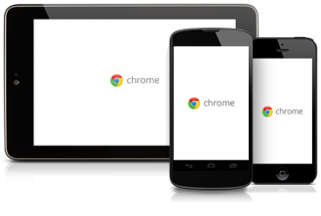
One FW Tool
What else is Possible
The tool can provide further features as added value
Developer Area
Support creating
and publishing
firmware packages
Server Functionality
Host Web Service
Or ASP .Net Server
Developer
Firmware
Data
Files
Browsing
Browse through the repository of available firmware versions on global platform
Client Functionality
Consume
Web Service
SESU
Global Platform
=S= Web Site
Global Platform

Slide 5
One FW Tool
What are the Benefits for our Customer
The tool will be the center of working with =S= firmware
Unique Experience, one tool for all =S= devices
independent of a new device or legacy device
Complete Support and Assistance, through the complete life cycle of the firmware from
Receiving the firmware from =S=,
Managing the firmware downloads,
Loading the firmware to a device

Slide 6
One FW Tool
What will be possible in Future
The tool can be extended outside of the firmware scope
Not Limited to Firmware, based on the flexibility of the new service and package definition.
The tool can also be used for:
 Loading Applications
Loading Devices Configurations
Handle all kind of Device related Data, with the help of the repository concept it is possible to manage all device relevant information, data and files
Extensibility, through the modular approach the tool can be extended by new communication and firmware loader (also legacy) plug-ins or other functionalities.

